Slide 1
Evidence Based Practices for Strategic & Tactical Firefighting

Slide 2
Learning Outcomes
To provide information and resources based on recent research focusing on modern fire behavior, building construction, and fireground strategy and tactics

Slide 3
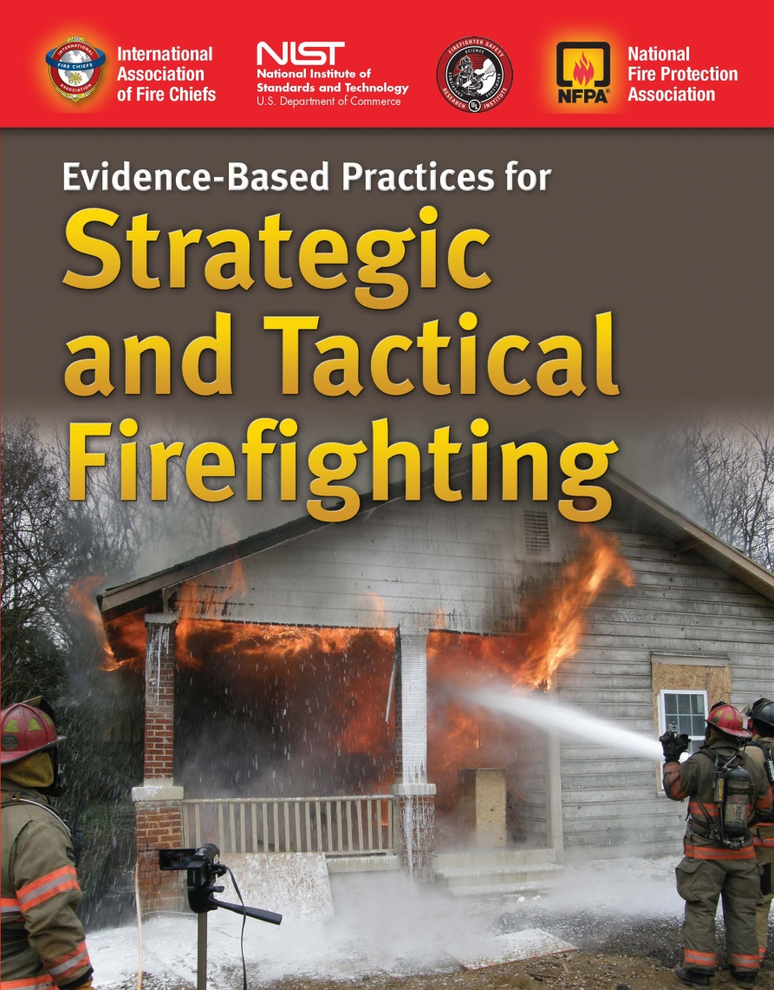
Evidence Based Practices for Strategic & Tactical Firefighting
Jones & Bartlett Learning developed this publication to inform the fire service on the research coming out of UL and NIST. Jones & Bartlett Learning’s hope is that it will help save lives.
Ideal for enhancing Fire Fighter I & II, Fire Science Degree, and Fire Officer development programs.

Slide 4
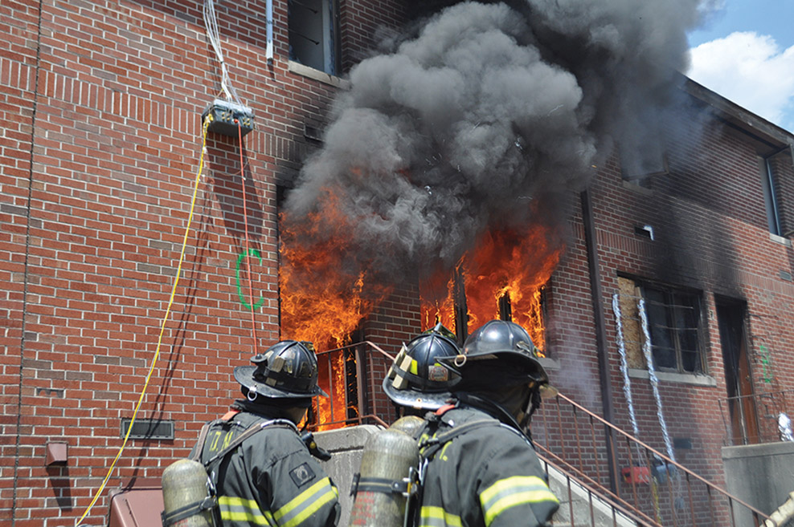
Introduction
Major changes in our understanding of basic fire behavior
Tactical options are increasing based on better assessment tools
Changes in building construction materials and techniques are occurring at a rapid pace
Changes in fuel types impact safe fireground operations
New terminology has emerged to reflect these changes
Courtesy of NIST.

Slide 5
Strategic and Tactical History
Principal means of developing strategy and tactics have been observation based.
These proven methods are still valuable
New research helps us further understand the actual progression of fire and the impact of each action taken.
Research has been based on live fire experiments in laboratory and acquired structure environments.

Slide 6
National Institute of Standards and Technology (NIST)
The Group enables advances in fire fighter safety, fireground operations, and effectiveness of the fire service; develops and applies technology, measurements, and standards, and improves the understanding of the behavior, prevention, and control of fires to enhance fire fighting operations and equipment, fire suppression, fire investigations, and disaster response.
http://www.nist.gov/fire/technology.cfm
Courtesy of NIST.

Slide 7
NIST Experiments and Reports
http://www.nist.gov/fire/index.cfm
D. Madrzykowski and R. L. Vettori. Simulation of the Dynamics of the Fire at 3146 Cherry Road NE Washington D.C., May 30, 1999. NISTIR6510, National Institute of Standards and Technology, Gaithersburg, Maryland, April 2000. http://www.nist.gov/customcf/get_pdf.cfm?pub_id=908795
D. Madrzykowski, G.P. Forney, and W. D. Walton. Simulation of the Dynamics of a Fire in a Two-Story Duplex–Iowa, December 22, 1999. NISTIR 6854, National Institute of Standards and Technology, Gaithersburg, Maryland, January 2002. http://www.nist.gov/customcf/get_pdf.cfm?pub_id=861122
R. L. Vettori, D. Madrzykowski, and W. D. Walton. Simulation of the Dynamics of a Fire in a One-Story Restaurant–Texas, February 14, 2000. NISTIR6923, National Institute of Standards and Technology, Gaithersburg, Maryland, October 2002. http://www.nist.gov/customcf/get_pdf.cfm?pub_id=861191

Slide 8
NIST Experiments and Reports
N. Bryner, S. P. Fuss, B. W. Klein, and A. D. Putorti. Technical Study of the Sofa Super Store Fire, South Carolina, June 18, 2007. NIST Special Publication 1118, National Institute of Standards and Technology, Gaithersburg, MD, March 2011. http://nvlpubs.nist.gov/nistpubs/SpecialPublications/NIST.SP.1118v1.pdf
A.Barowy and D. Madrzykowski. Simulation of the Dynamics of a Wind-Driven Fire in a Ranch-Style House–Texas. NIST Technical Note 1729, National Institute of Standards and Technology, Gaithersburg, Maryland, 2012. http://www.nist.gov/customcf/get_pdf.cfm?pub_id=909779
C. G. Weinschenk, K. J. Overholt, and D. Madrzykowski. Simulation of an Attic Fire in a Wood Frame Residential Structure–Chicago, IL. NIST Technical Note 1838, National Institute of Standards and Technology, Gaithersburg, Maryland, 2014. http://nvlpubs.nist.gov/nistpubs/TechnicalNotes/NIST.TN.1838.pdf
K. J. Overholt, C. G. Weinschenk, and D. Madrzykowski. Simulation of a Fire in a Hillside Residential Structure–San Francisco, CA. NIST Technical Note 1856, National Institute of Standards and Technology, Gaithersburg, Maryland, 2014. http://nvlpubs.nist.gov/nistpubs/TechnicalNotes/NIST.TN.1856.pdf

Slide 9
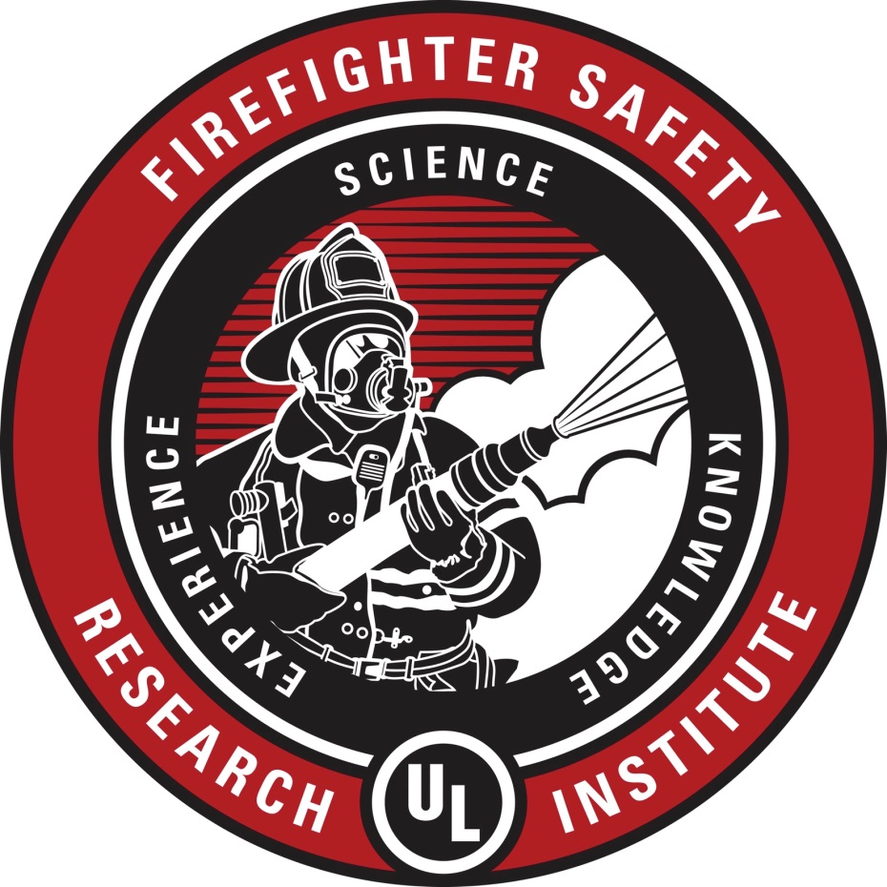
Underwriters Laboratories (UL)
UL’s Firefighter Safety Research Institute is dedicated to increasing fire fighter knowledge to reduce injuries and deaths in the fire service and in the communities they serve.
Courtesy of UL.

Slide 10
UL Experiments and Reports
Comparison of Modern and Legacy Home Furnishings
Effectiveness of Fire Service Vertical Ventilation and Suppression Tactics
Fire fighter Exposure to Smoke Particulates
Fire fighter Safety and Photovoltaic Systems
Governors Island Experiments
Impact of Ventilation on Fire Behavior in Legacy and Contemporary Residential Construction
Improving Fire Safety by Understanding the Fire Performance of Engineered Floor Systems
Structural Stability of Engineered Lumber in Fire Conditions
Study of Residential Attic Fire Mitigation Tactics and Exterior Fire Spread Hazards
Fire Service Positive Pressure Ventilation During Fire Attack in Single family Dwellings

Slide 11
New Firefighting Vocabulary and Terminology
Flow Path
Vent Point Ignition
Bi-Directional Flow Path*
Ventilation Limited Fire
Fuel Limited Fire
Vent-Enter-Isolate-Search
Transitional Attack
Heat Release Rate
Notes:
*Bi-Direction has also been called Two-Way or Uni-directional

Slide 12
Fire Behavior
With improved understanding of fire behavior, the importance of controlling ventilation is a key factor to safe and effective operations.
Safer and more efficient methods for conducting search operations have emerged.
Fire fighter safety and survival are improved through quicker suppression techniques.

Slide 13
Flashovers
Increased incidents of violent and rapid flashovers are being encountered in residential fires.
UL and NIST studies have been conducted to provide knowledge and tools to better understand this phenomenon.
Testing has included full-scale burns in both laboratory and acquired structures.

Slide 14
Fire Behavior Research Yields Better Understanding
Fire Dynamics
Ventilation and flow paths; how fires spread
Applying water; coordinating fire attack
Rescue and safety considerations
Basement fires

Slide 15
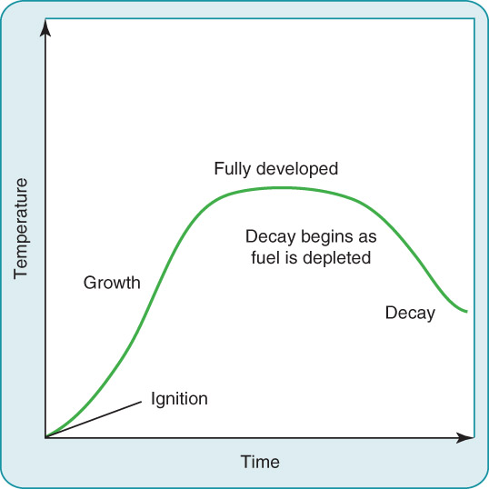
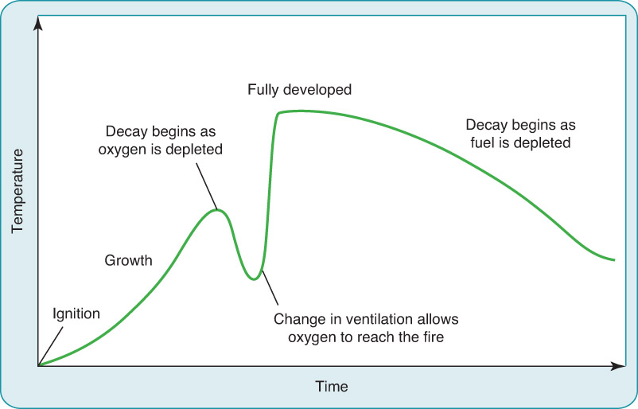
Fire Growth Curve Comparison
Courtesy of NIST.

Slide 16
Fire Dynamics
Legacy vs. modern fueled and built environments
Building materials changed
Fuels have changed

Slide 17
Modern Construction Concerns
Higher performing insulating materials and lighter weight materials change the way fires burn.
Solid dimensional lumber has been replaced with lower mass materials and manufactured structural components.
Furniture constructed of materials derived from petroleum products are found in every room of a modern home.
Heat Release Rate increases as fires burn hotter and faster and the methods of heat transfer in a tightly sealed house have resulted in rapid fire spread.

Slide 18
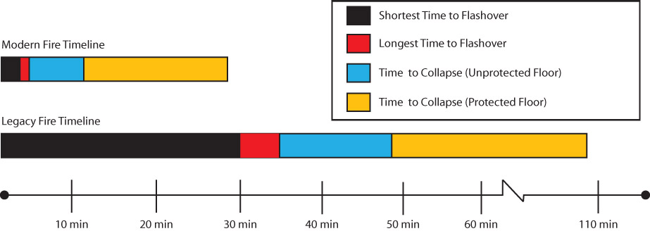
Modern vs. Legacy Timelines
Reproduced from: Fire Technology 48(4): 865-891, “Analysis of Changing Residential Fire Dynamics and Its Implications on Firefighter Operational TimeFrames”, Kerber, S., Copyright © 2012, National Fire Protection Association

Slide 19
Flashover Comparison
Courtesy of UL.

Slide 20
Factors that Change the Way Fires Burn in Modern Houses
Courtesy of UL.

Slide 21
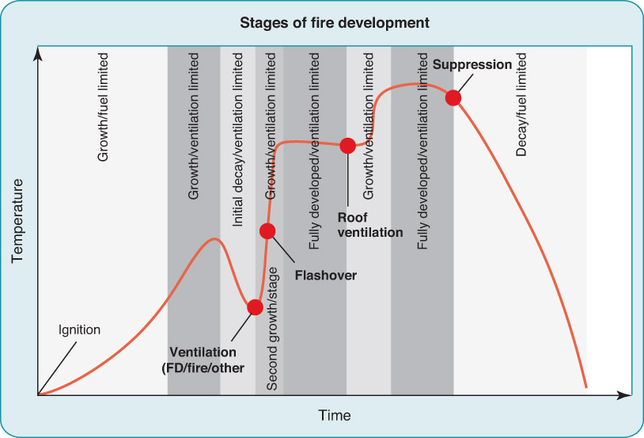
Stages of Fire Development in a Single Family Dwelling
Courtesy of UL.

Slide 22
Fuel and Construction Combinations
Produce new fire dynamics
Fires may grow rapidly and then enter a stage of dormancy due to insufficient levels of oxygen for the fuels involved
This may occur before a fire has reached flashover
Result is a ventilation-limited fire
A fire that cannot grow into a fully developed or free burning fire as the environment has become too fuel- rich

Slide 23
Ventilation-Limited Fires
These fires result in an environment that waits for the introduction of fresh air that creates rapid and hostile fire growth.
Making entry through the front door in these instances can introduce enough air into the fire area to produce rapid fire growth and flashover.
Firefighters need to be aware that any opening in the structure constitutes ventilation.
This has not been traditionally taught in many instances
Repeated experiments have produced violent flashovers shortly after the front door is opened.

Slide 24
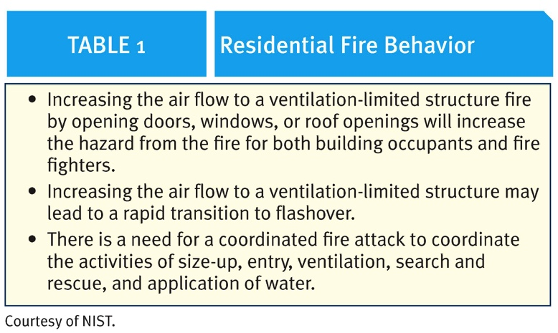
Results of Tests with NIST, UL, and FDNY

Slide 25
Ventilation and Fire Flow Paths
Effective fire extinguishment takes place when you understand how fires spread
All firefighters know the basic principles of fire spread
Conduction
Convection
Radiation
Fire triangle
All smoke, particulates, and fire gases are fuel

Slide 26
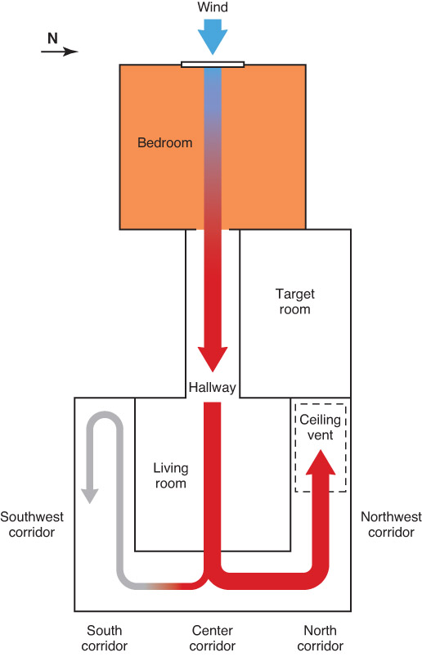
Flow Path and Fire Spread
Fire spread is largely a pressure-driven event
Fire spreads along a flow path
Flow path is the lower pressure space between an inlet for fresh air (door or window), the fire, and the higher-pressure space between the fire and the outlet for hot gases and smoke (open window or roof vent)
Courtesy of NIST.

Slide 27
Bi-Directional Flow Path
Fire creates a flow path of hot gases exiting through the top part of the door while the bottom half will allow introduction of cool oxygen-rich air into the fire
This is created (for example) when only the front door is opened during a fire
Result is bi-directional flow path

Slide 28
Single Direction Flow Paths
Result when openings on the structure are positioned to produce exclusive ports for the entry of oxygen rich airflow OR the release of hot gases from the structure.
Directly impacted by changes in elevation between the inlet and outlet openings.
Flow paths can move through a building, pushing hot gases along it.
If adequate oxygen mixes with the hot gases, the entire flow path can become a rapidly moving wall of flames.
Firefighters cannot survive these conditions for more than a few seconds.

Slide 29
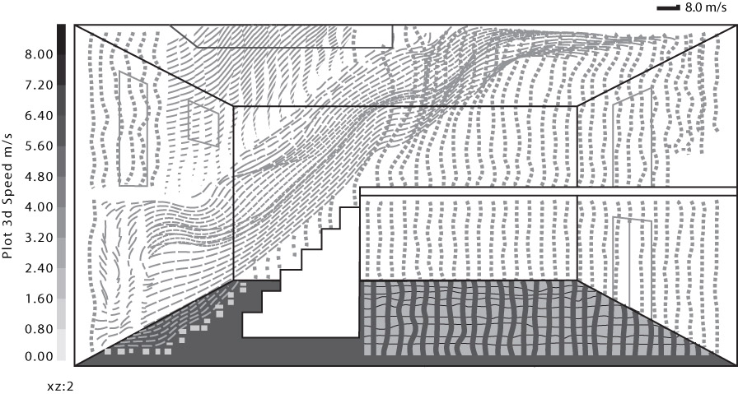
Flow Path LODD Simulation
Reproduced from: Madrzykowski, Daniel (2013) Fire Dynamics: The Science of Fire Fighting. International Fire Service Journal of Leadership and Management. Vol 7.Number 2, page 7 – 15. Tulsa, OK: Oklahoma State University. Courtesy of National Institute of Standards and Technology

Slide 30
Ventilation and Flow Path Key Points
© Jones & Bartlett Learning.

Slide 31
Fire Growth and Development
Amount of air entering the fire area
Opening a door or window provides oxygen to a ventilation limited fire
Amount of gases exiting the fire area
Providing an opening in a roof creates an exit flow path for hot fuel
Accelerates air flow into the fire as well as spreading the fire along the flow path

Slide 32
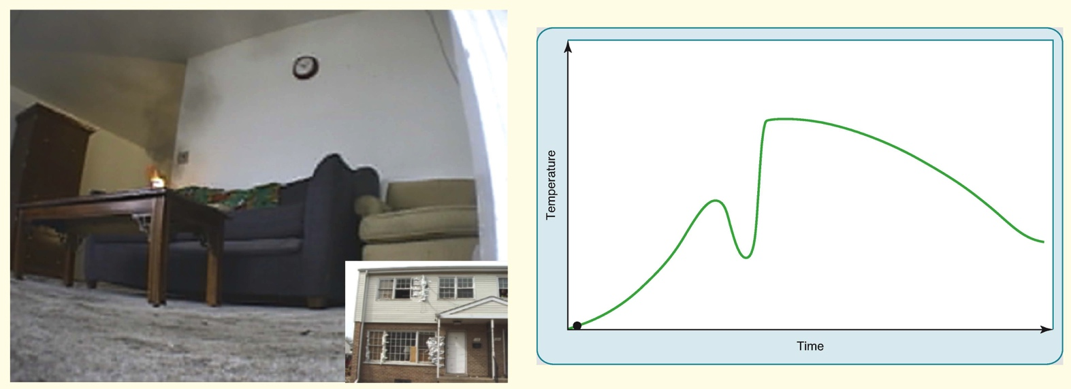
Ventilation-Limited Fire Growth
Courtesy of NIST.

Slide 33
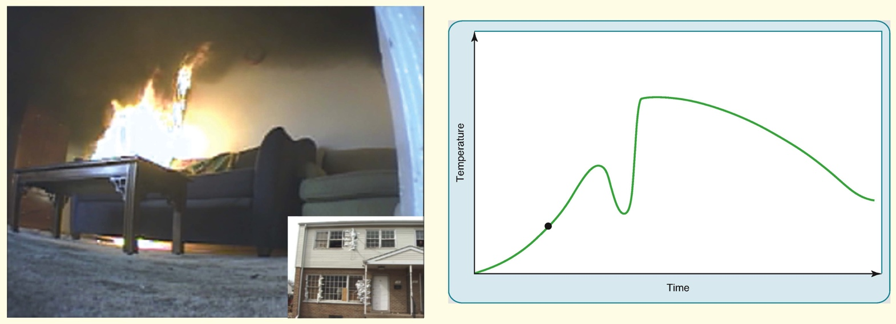
Ventilation-Limited Fire Growth
Courtesy of NIST.

Slide 34
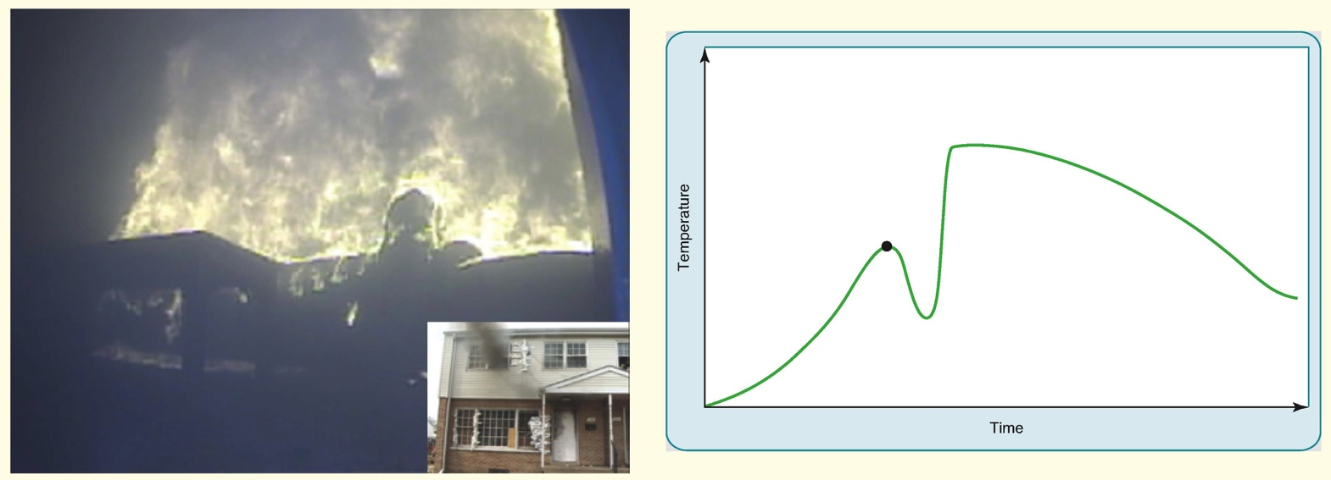
Ventilation-Limited Fire Growth
Courtesy of NIST.

Slide 35
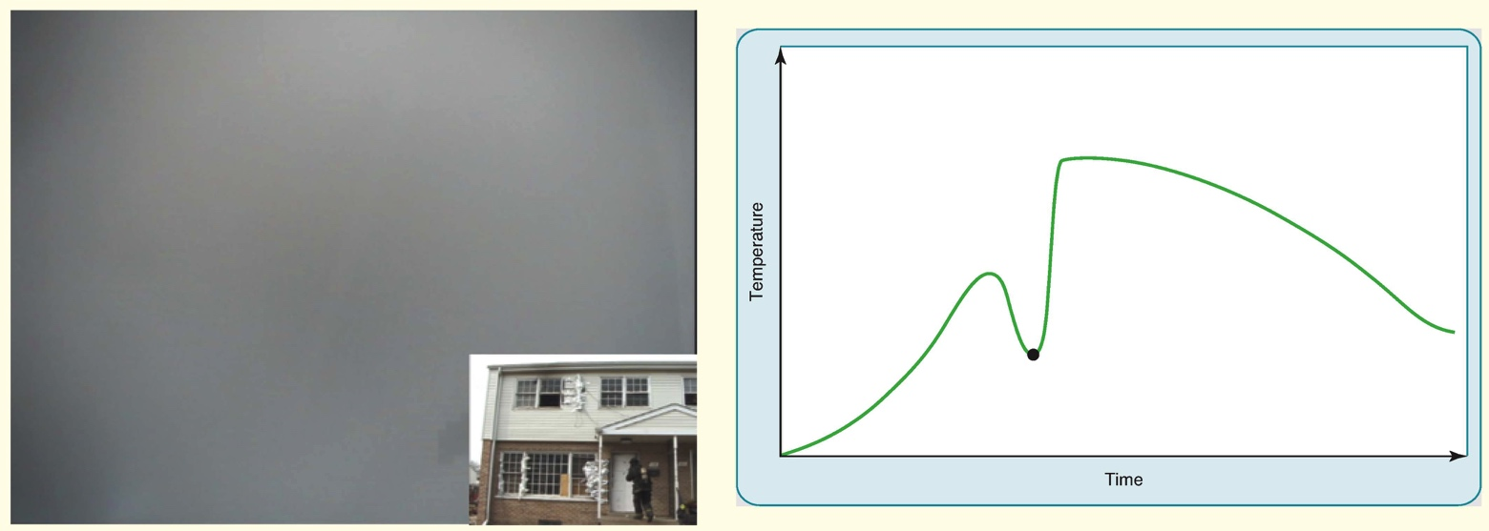
Ventilation-Limited Fire Growth
Courtesy of NIST.

Slide 36
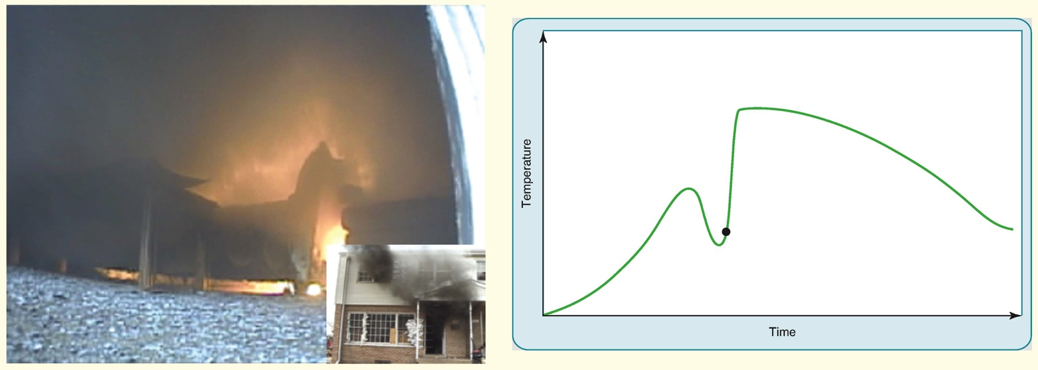
Ventilation-Limited Fire Growth
Courtesy of NIST.

Slide 37
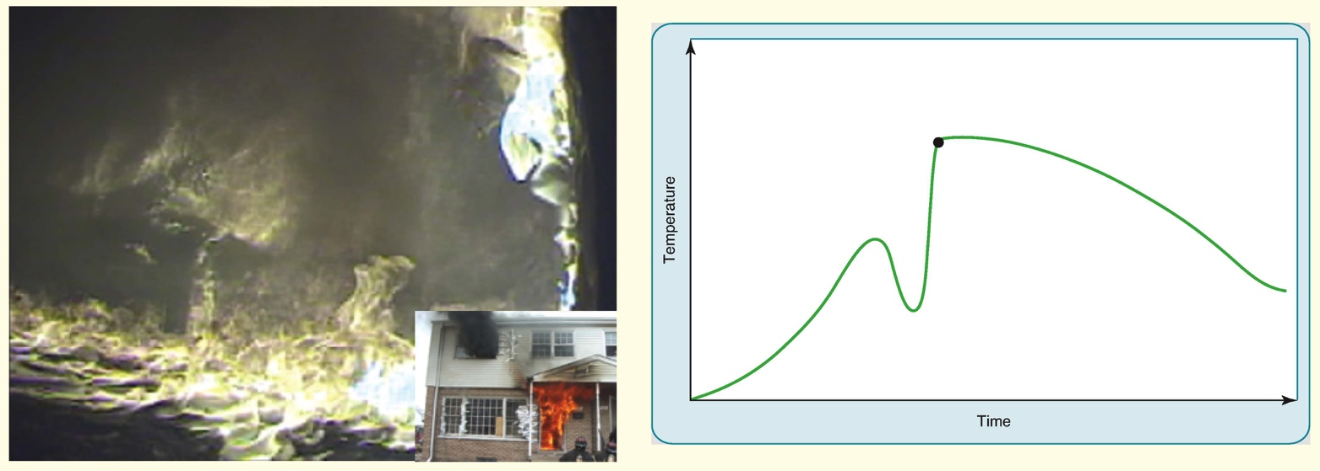
Ventilation-Limited Fire Growth
Courtesy of NIST.

Slide 38
Controlling the Flow Path
Limiting oxygen available to the fire until suppression actions can take place can keep the fire smaller and limit heat release rate (HRR).
Since opening the front door is considered ventilation, this action should be delayed until suppression crews are ready to, or have already cooled the fire area.
Careful coordination between suppression and ventilation is critical to a safe and effective outcome.

Slide 39
NIST, UL, and FDNY Fire Flow Path Findings

Slide 40
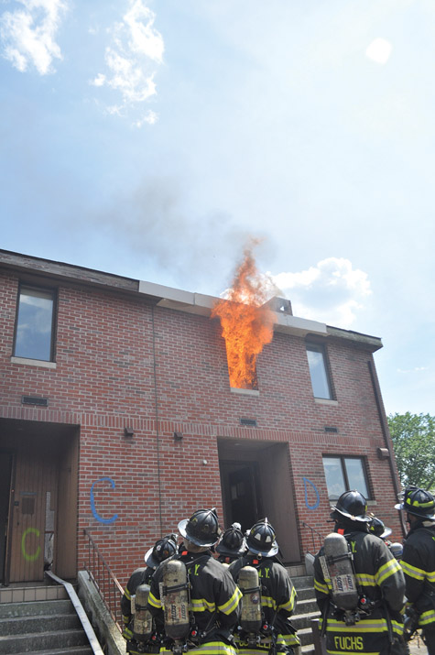
Applying Water: Coordinating Fire Attack
Primary means of suppressing fires is to apply water.
Traditionally it has been taught that fires should be fought from the unburned side for fear of pushing fire with fire streams.
Courtesy of UL.

Slide 41
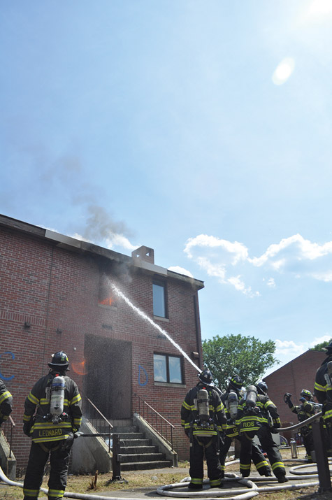
Transitional Attack Option
Considered an offensive exterior attack
Purpose is to reduce fire spread, limit HRR, and reduce temperature to a safer level
Reduction of flashover potential
Used in sequence prior to entry of lines into building if indicated
Hit visible fire from outside then enter structure for extinguishment and other operations
Courtesy of UL.

Slide 42
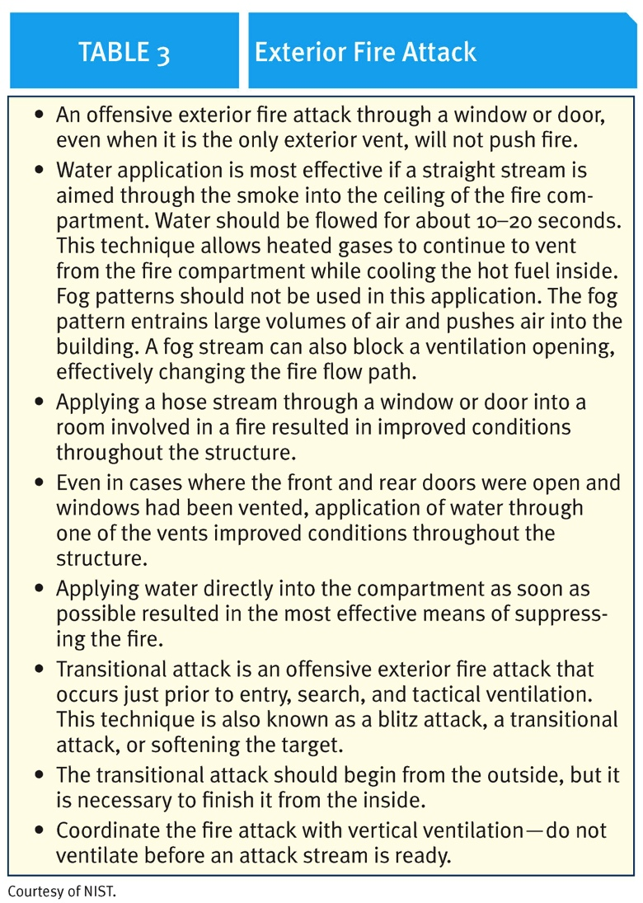
Exterior Offensive Fire Attack

Slide 43
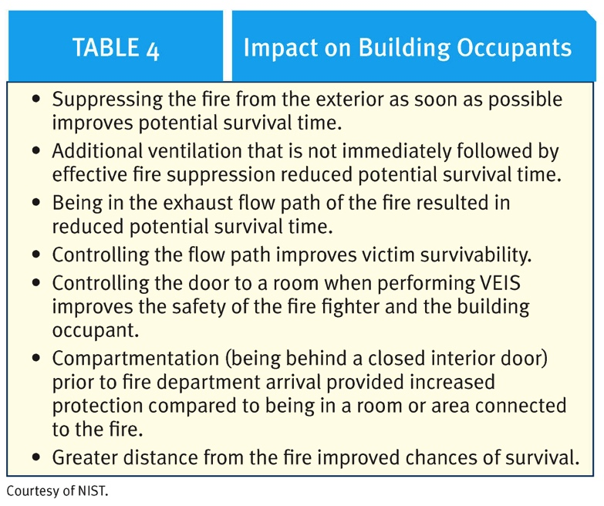
Impact on Building Occupants

Slide 44
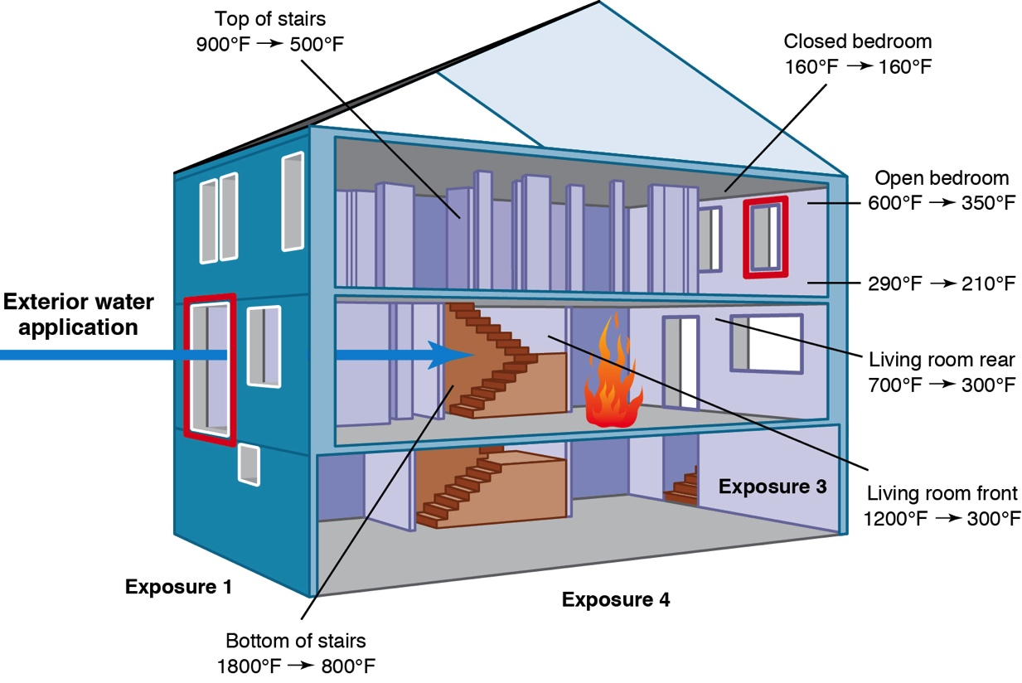
Pre/Post Water Application Temperature Examples – Single Family House

Slide 45
Offensive Exterior or Transitional Attack
Courtesy of UL.

Slide 46
Research-Based Fire Attack Key Points

Slide 47
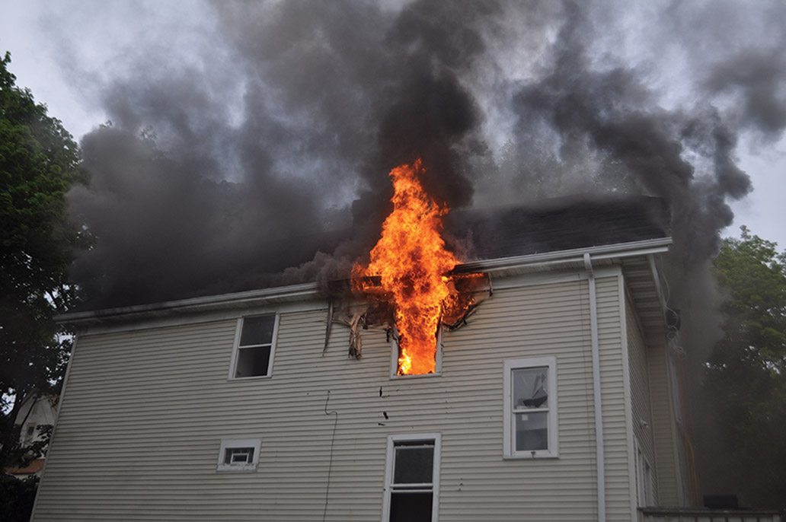
Rescue and Safety Considerations
All of the previously discussed research increases knowledge of rescue techniques.
Closing any door between fire and other parts of building will improve that environment for occupants or a trapped fire fighter.
Vent-Enter-Search has become Vent-Enter-Isolate-Search.

Slide 48
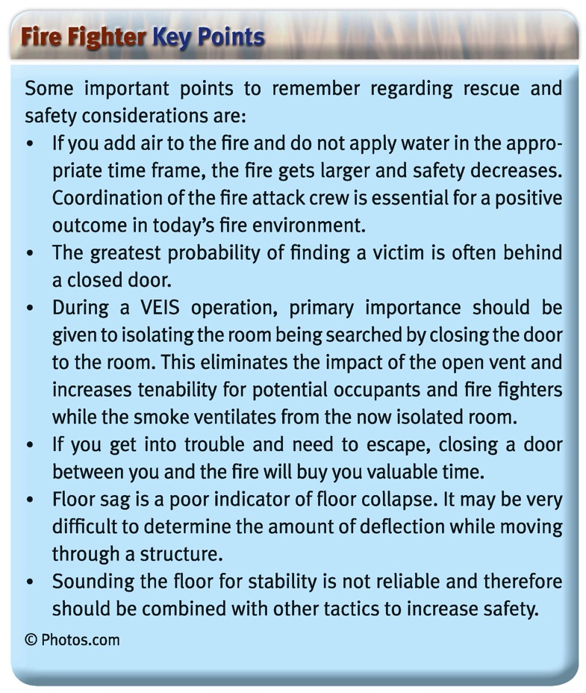
Research-Based Search and Rescue Key Points

Slide 49
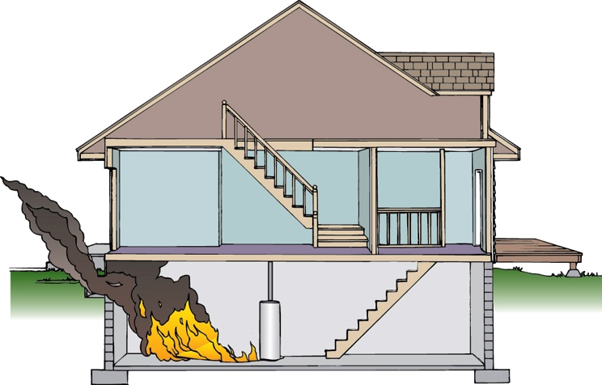
Basement Fires
Basement fires present unique hazards due to building construction methods and materials
Void spaces and unfinished raw materials often present
Quick failure of structural components is primary hazard
Attack straight down stairs may not be safe option since it places personnel on the outlet side of a uni-directional flow path in most situations

Slide 50
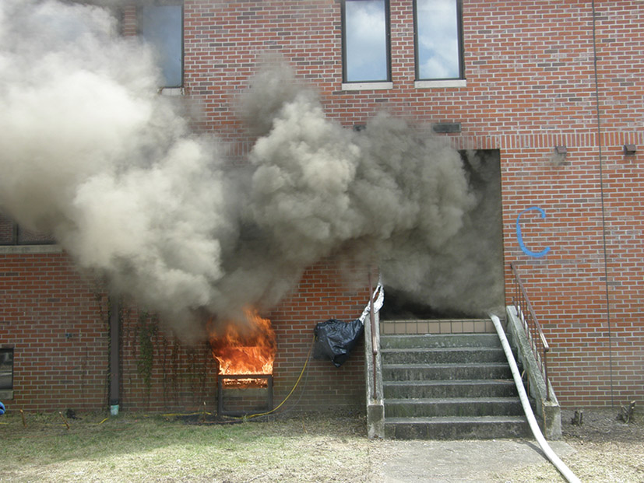
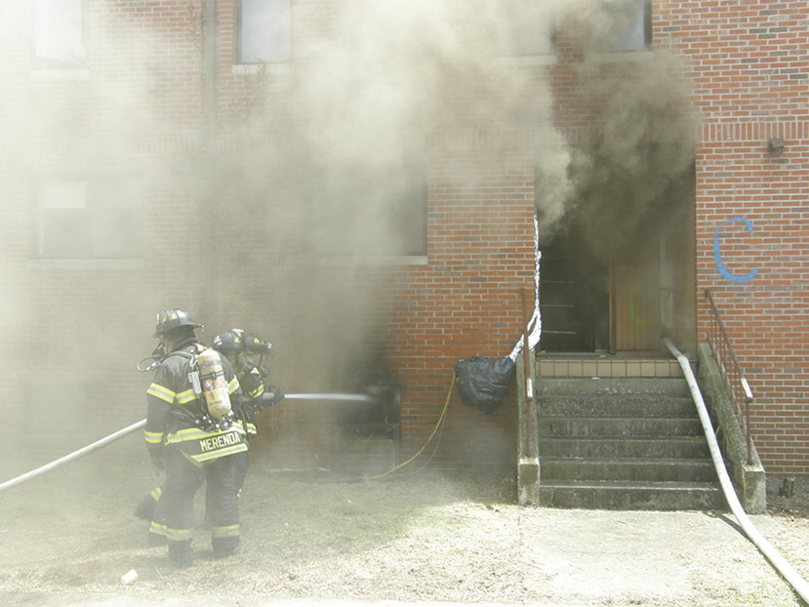
Basement Fire Attack

Slide 51
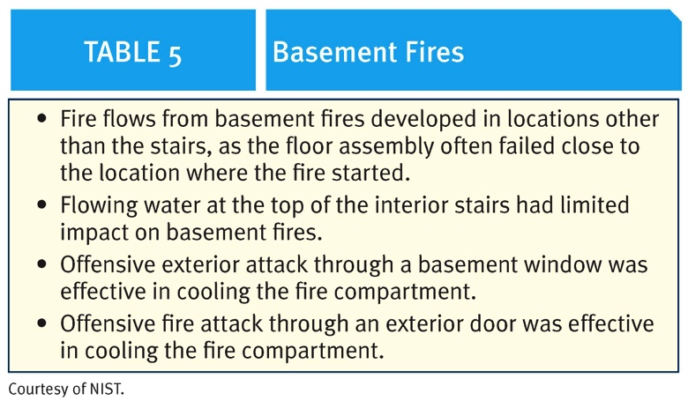
Research-Based Basement Fire Key Points

Slide 52
Continued Research
Additional studies are underway or planned to continue to study the most effective means of applying water to a fire.

Slide 53
Summary
Review Hot Terms
Review all FF Key Points from article

